Slide 1
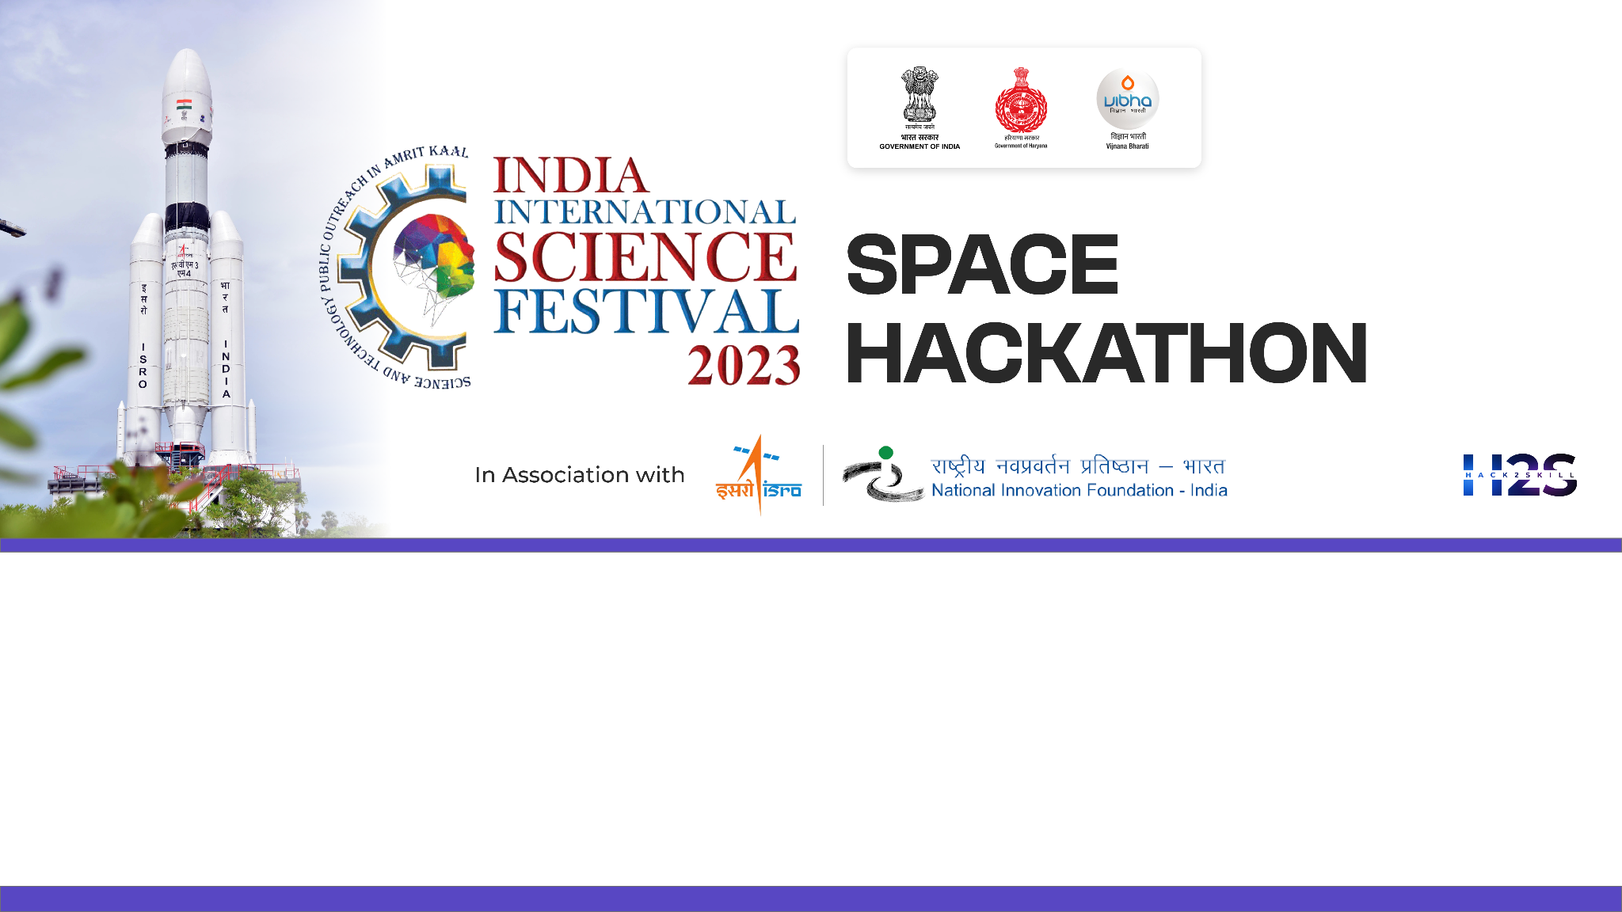

Team Name: Geo-Extractors
Name of College/University: Andhra University College Of Engineering
Team Member Details:
BANDI JAYASATYADURGARAO
JAGU MANISH
GAUTAM KUMAR KUSHWAHA
CHATTI VENKATA RAVITEJA

Slide 2

Problem Statement: Feature Extraction from RS‐HR data using AIML
MOTIVATION:
The challenge in remote sensing lies in extracting vital features like Farm Pond, Check Dam, Nala Pond, Dug Wells, High Tension Tower, Windmill, etc.. from HR-Satellite images.
For applications such as utility management & planning, water resource management, renewable energy, etc.
Manual identification is error-prone (Human expert decision-based errors), Laborious, and time-consuming.
To create a feature extraction knowledge engine, by incorporating hybrid ML, DL, and CNN models.
BACKGROUND:
Advanced automated analysis of satellite imagery across varied environments for diverse applications.
Customized labeled Datasets for multiple features.
Adaptability to New Feature Types
Extensive Generalization

Slide 3
Detailed Proposal & Solution Approach
OUR SOLUTION:
Automatic Feature extraction model with a state-of-the-art multi-label classification system that delivers precision through bounding boxes, masks, and confidence scores for each identified feature.
Class-wise labels are generated by taking ground validation data, employing various Image segmentation techniques to label distinct features, complemented by applying diverse OBIA classification methods through Deep neural networks(CNN).
Creating an Automated multi-label classification model entails initial training with diverse datasets, followed by retraining using meticulously crafted labeled datasets that cover various features. The model then outputs bounding boxes for each detected feature, accompanied by corresponding confidence scores.
Using Data augmentation Techniques to make the model robust and accurate for satellite imagery.
Environmental Dependencies
Data quality and variability
Computational Resource Requirements

Slide 4
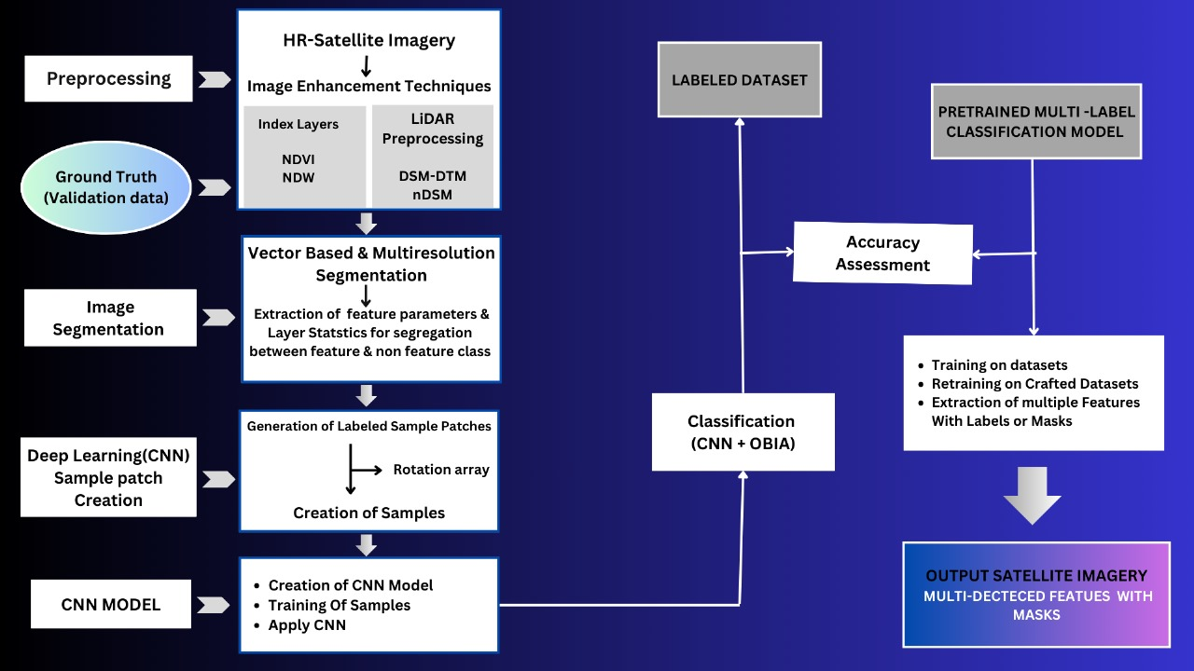
DETAILED METHODOLOGY

Slide 5
Tools and devices used on development
eCognition
QGIS
OpenCV
PyTorch
Jupyter Notebook
TensorFlow
Technologies involved/used
GIS
Remote Sensing
Digital Image Processing
AI/ML/DL
GIS
OBIA (Object Based Image Analysis)
LiDAR Imaging
References/Acknowledgement
<Reference Doc Name and URL>

